Slide 1




Unmanned Aerial Vehicle Flight System Failure and Radio Range Analysis
William Willie Wells
NSF IIA-1539070 https://en.wikipedia.org/wiki/File:NSF_Logo.jpg
USDA-NIFA 2013-67021-20947
https://commons.wikimedia.org/wiki/File:US-DeptOfAgriculture-Seal.svg
Notes:
Good {Time of Day}
Defense, title
Work at, funded by

Slide 2
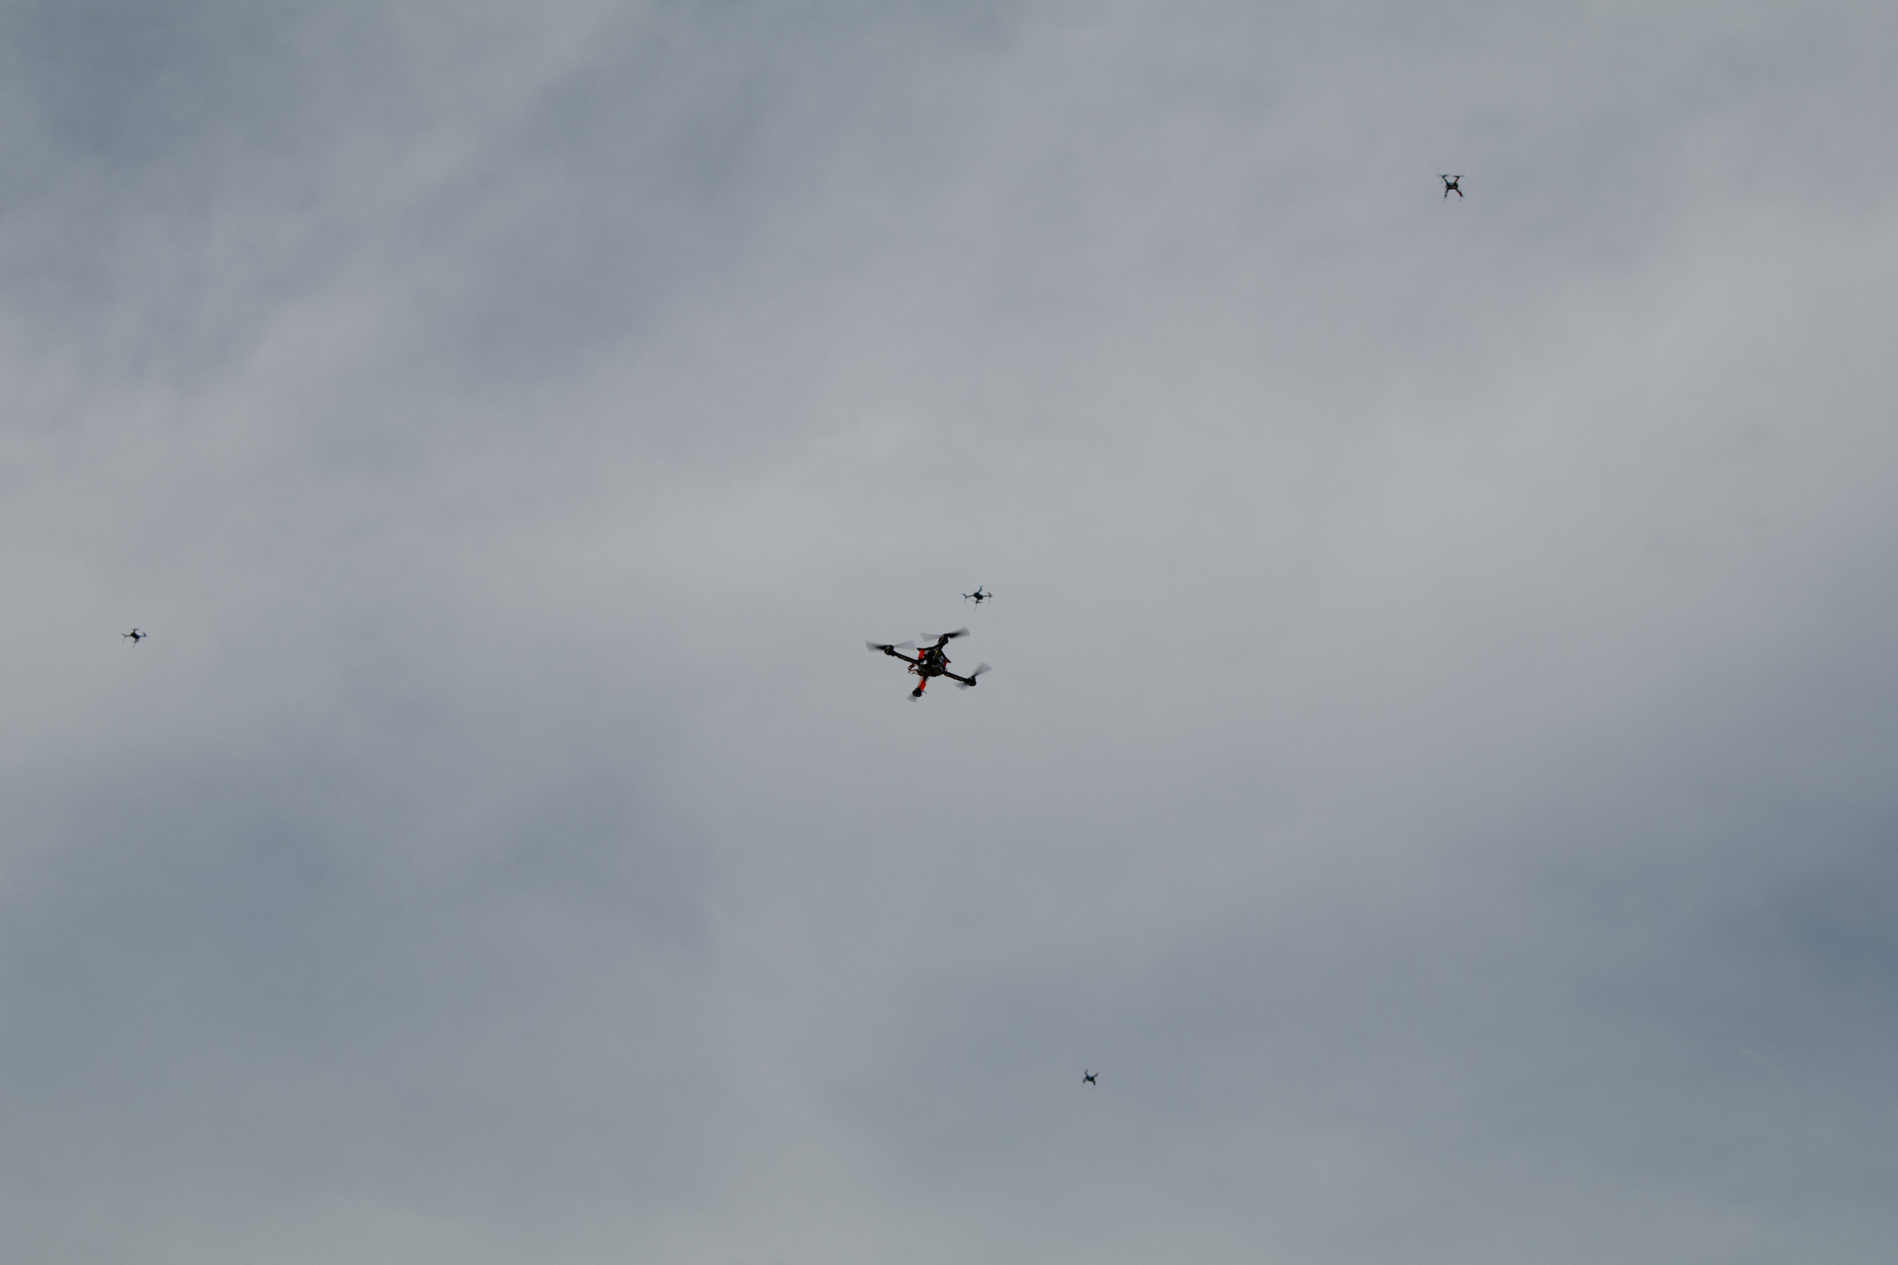
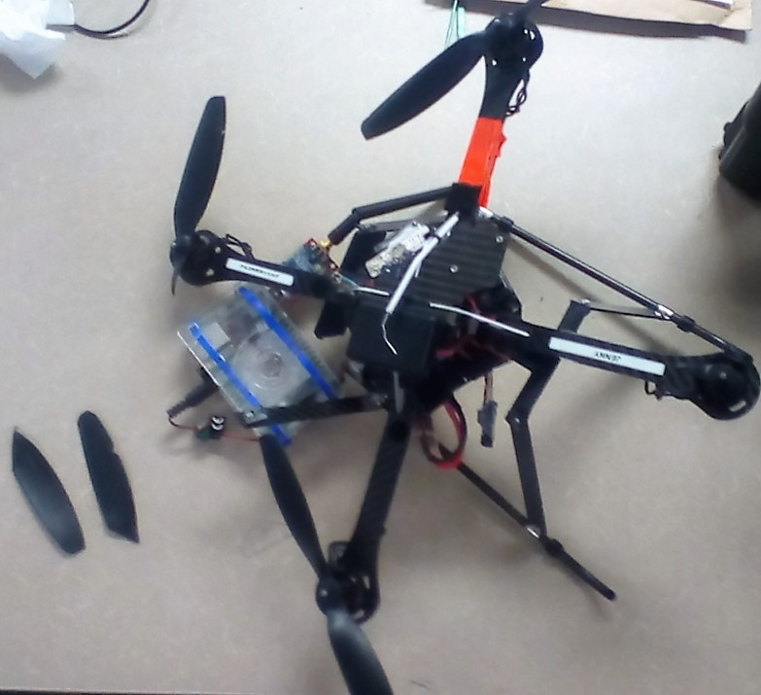
Motivation
Use of UAVs
Advantages:
Man-hours required to perform a task
Human risk in hazardous environments
Economic cost per task
Disadvantage:
Low reliability
Notes:
Increase of UAV use globally, Why should I care?
These advantages, uavs are faster at gathering data, uavs reduce human risk natural disaster, deploy uav cheaper than hiring someone
Manned aircraft more reliable.

Slide 3
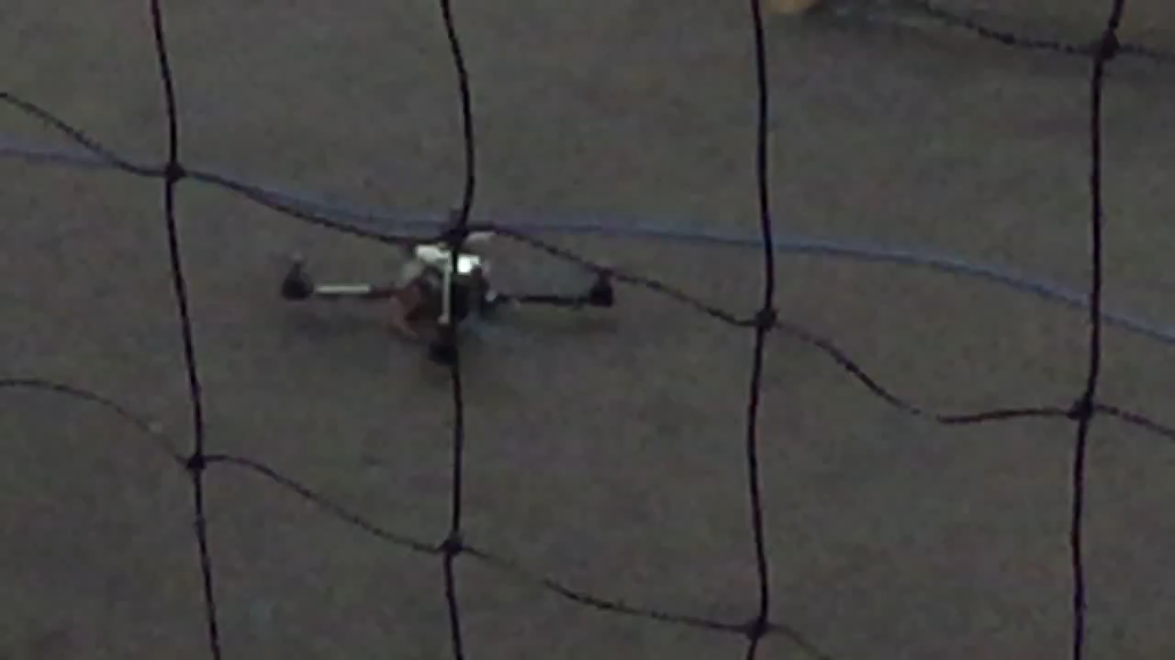
Unmanned Aerial Vehicle Failure
Notes:
What and Why? This is an AscTec Hummingbird.
A failed motor assembly, Identify why, emphasizes danger

Slide 4
Manned Aircraft Related Work
Lee, H. et al. (2016). Aircraft Actuator Fault Detection and Isolation using Piecewise Constant Fault Estimation Scheme. AIAA Guidance, Navigation, and Control Conference.
Pappu, V. S. R. et al. (2015). Hardware-In-Loop and Flight Testing of Modified State Observer Based Adaptation for a General Aviation Aircraft. AIAA Guidance, Navigation, and Control Conference.
Steinberg, M. (2005). Historical Overview of Research in Reconfigurable Flight Control. Proceedings of the Institution of Mechanical Engineers, Part G: Journal of Aerospace Engineering.
UAV Testing Related Work
Cork, L., Walker, R. (2007). Sensor Fault Detection for UAVs using a Nonlinear Dynamic Model and the IMM-UKF Algorithm. In Information, Decision and Control.
Heredia, G. et al. (2009). Multi-Unmanned Aerial Vehicle (UAV) Cooperative Fault Detection Employing Differential Global Positioning (DGPS), Inertial and Vision Sensors. Sensors.
Zhang, Y. M. et al. (2013). Development of advanced FDD and FTC techniques with application to an unmanned quadrotor helicopter testbed. Journal of the Franklin Institute.
Radio Testing Related Work
Palmer, J. et al. (2015). On air-to-water radio communication between UAVs and water sensor networks. In 2015 IEEE International Conference on Robotics and Automation (ICRA).
Rusdy, Y. M. et al. (2012). Effect of Distance on the Maximum Data Transfer for Different Mounting Elevations of XBee Pro Module in Viral Advertisement System. Presented at the 2012 2nd International Conference on Electrical Engineering and Applications, Bali.
Shaw, A., Mohseni, K. (2011). A Fluid Dynamic Based Coordination of a Wireless Sensor Network of Unmanned Aerial Vehicles: 3-D Simulation and Wireless Communication Characterization. IEEE Sensors Journal.
Notes:
Lee – a scheme actuator FDI; Pappu – used an observer, FTC algorithm; Steinberg – review of algorithms for FDI and FTC (redundancy)
UAV testing – FDD and FTC
Cork – sensor FDD; Heredia – sensor FTC; Zhang – compare algorithms for FDD and FTC; assume fault is in actuator or sensor
Radio Testing; Palmer – comms UAV n water nodes, water node comms;
-Related Work: highlight the contributions of the works to the general category they are under and also to briefly discuss what they didn't do.

Slide 5
Project Investigation Topics
1. Reliability and Failure
Under what conditions does an unmanned aerial vehicle fail?
How reliable is each unmanned aerial vehicle?
Time and Time Delay
Is the execution time for a failed test the same as the average time for a successful test?
Position
How precise is the position obtained versus the target positions?
Energy Consumption
What is the average energy consumption?
What tasks require more energy consumption than the average task?
2 . Radio Range
What is the effective radio range of paired XBee-Pros?
Which antenna length combination results in furthest range?
3 . GPS
Can affordable RTK GPS receivers replace existing GPS receivers.
Notes:
Project Investigation Topics,
These are the questions that this project sought to address.

Slide 6
Presentation Outline
Flight System Test Setup
Reliability and Failure
Under what conditions does an unmanned aerial vehicle fail?
How reliable is each unmanned aerial vehicle?
Time and Time Delay
Is the execution time for a failed test the same as the average time for a successful test?
Radio Range
What is the effective radio range of paired XBee-Pros?
Which antenna length combination results in furthest range?
Future Work and Conclusions
Notes:
Talk a little more about each, add topics

Slide 7
Presentation Outline
Flight System Test Setup
Reliability and Failure
Time and Time Delay
Radio Range
Future Work and Conclusions
Notes:
The following slides present the Flight System Test setup

Slide 8
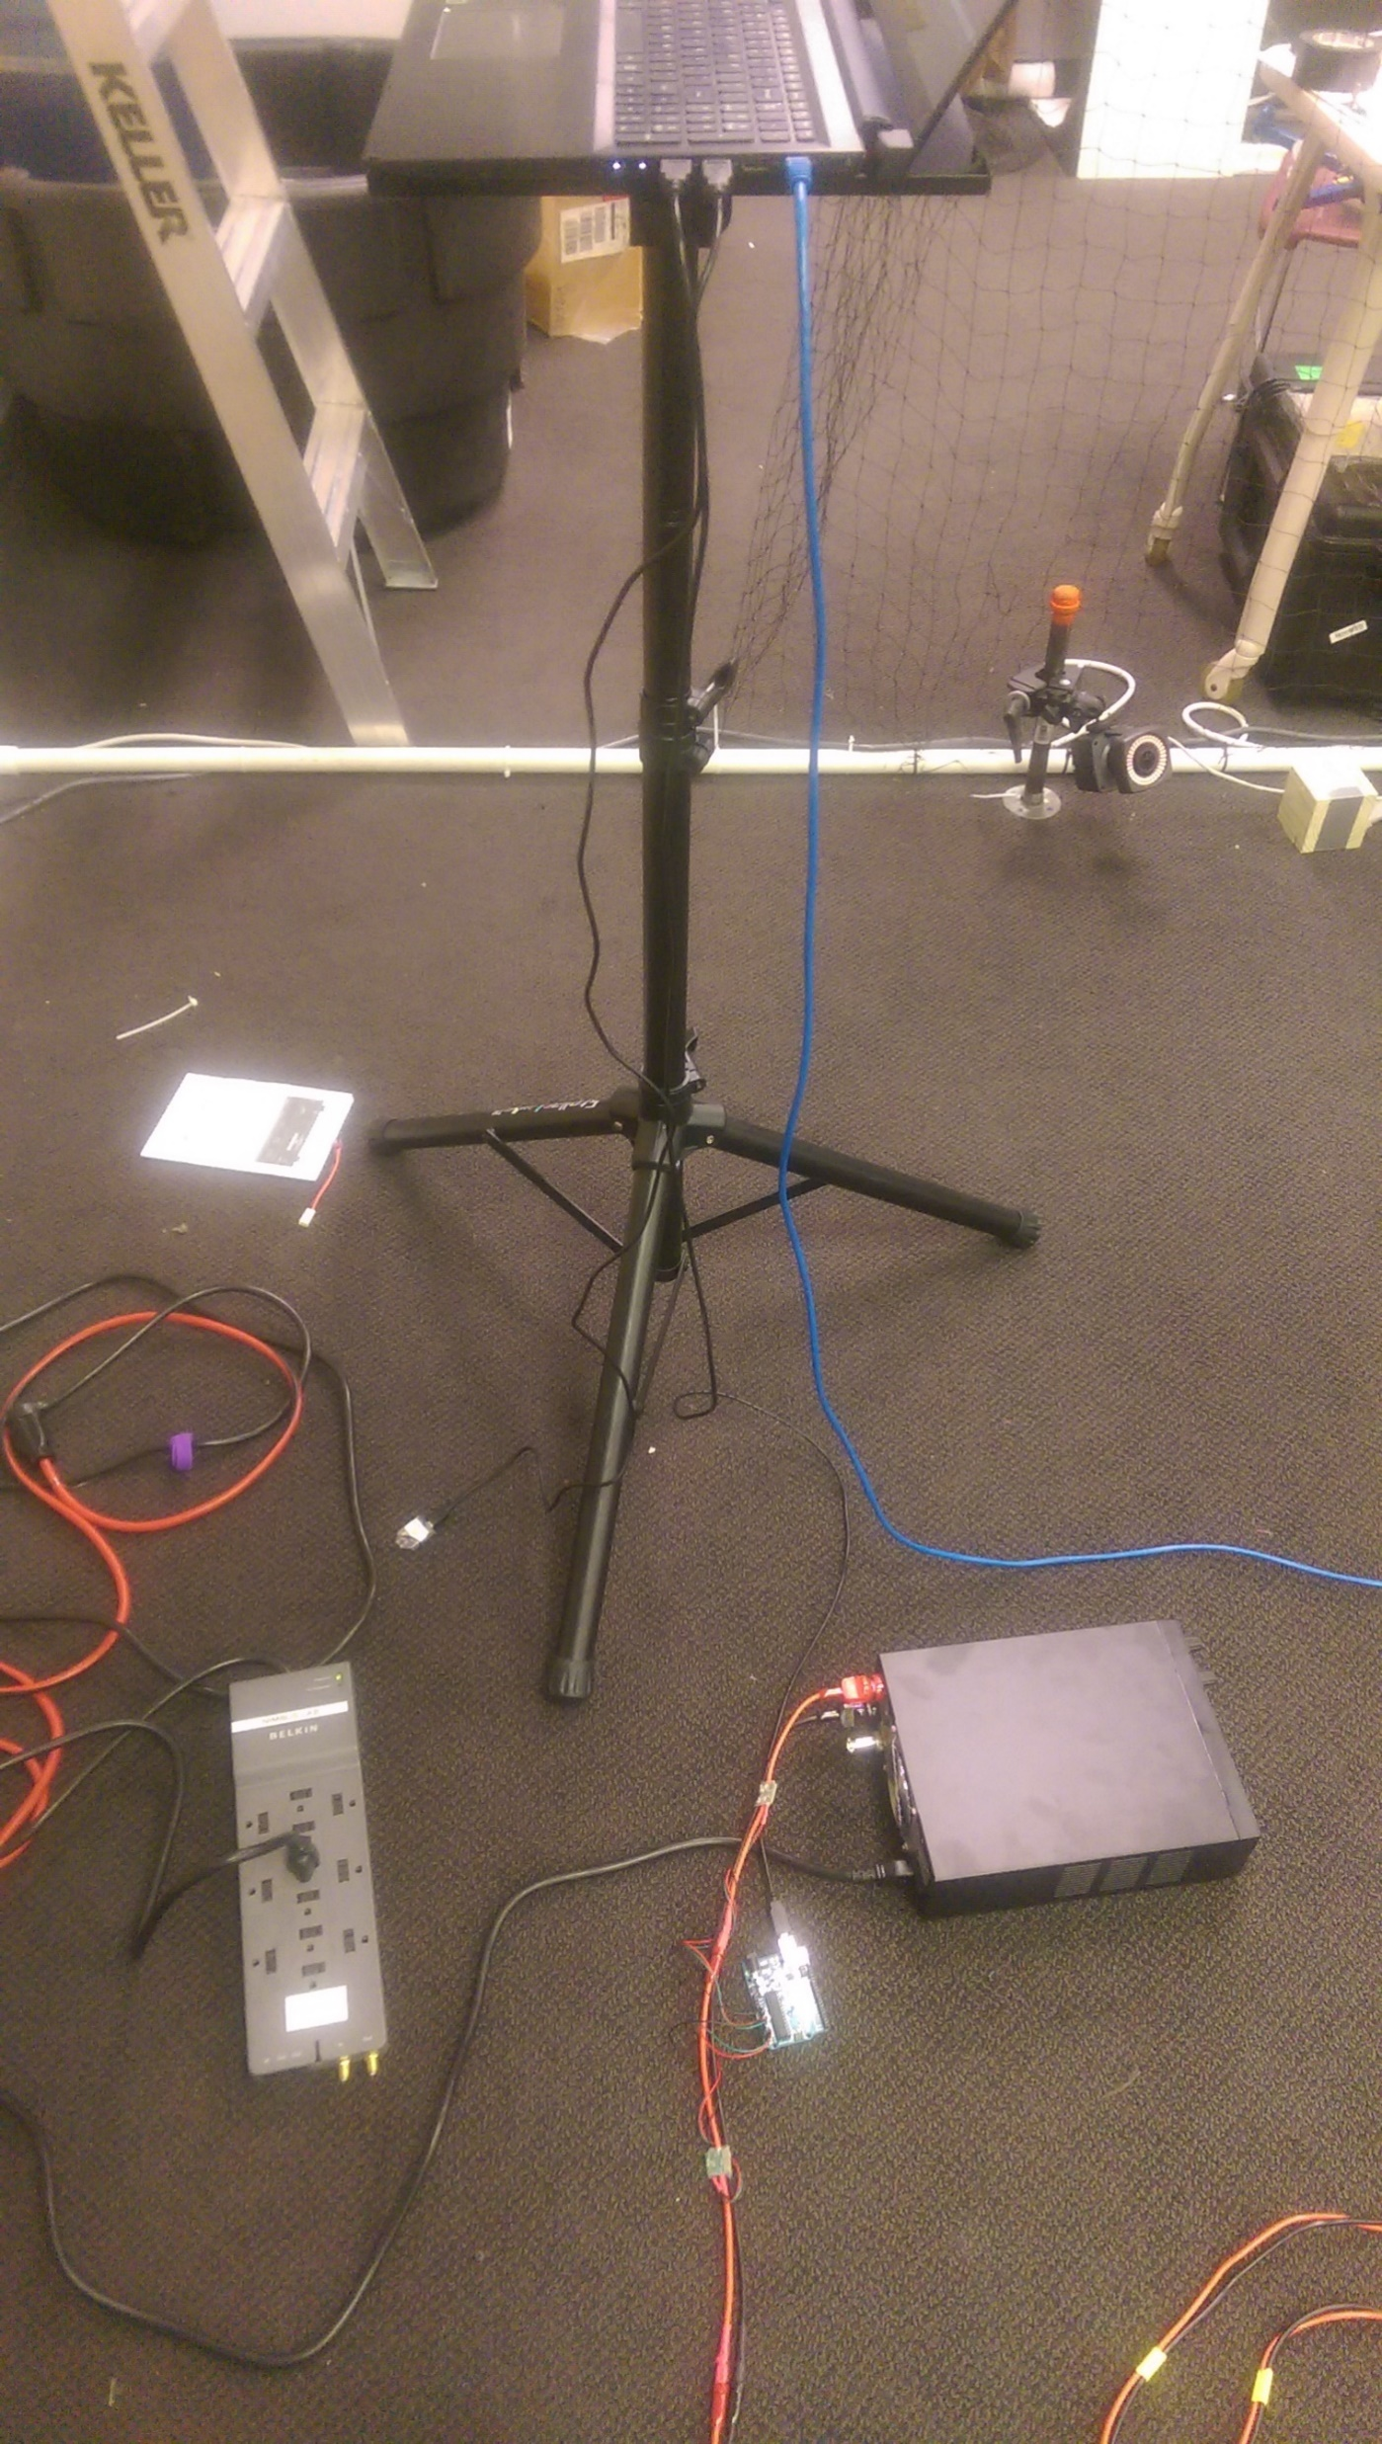
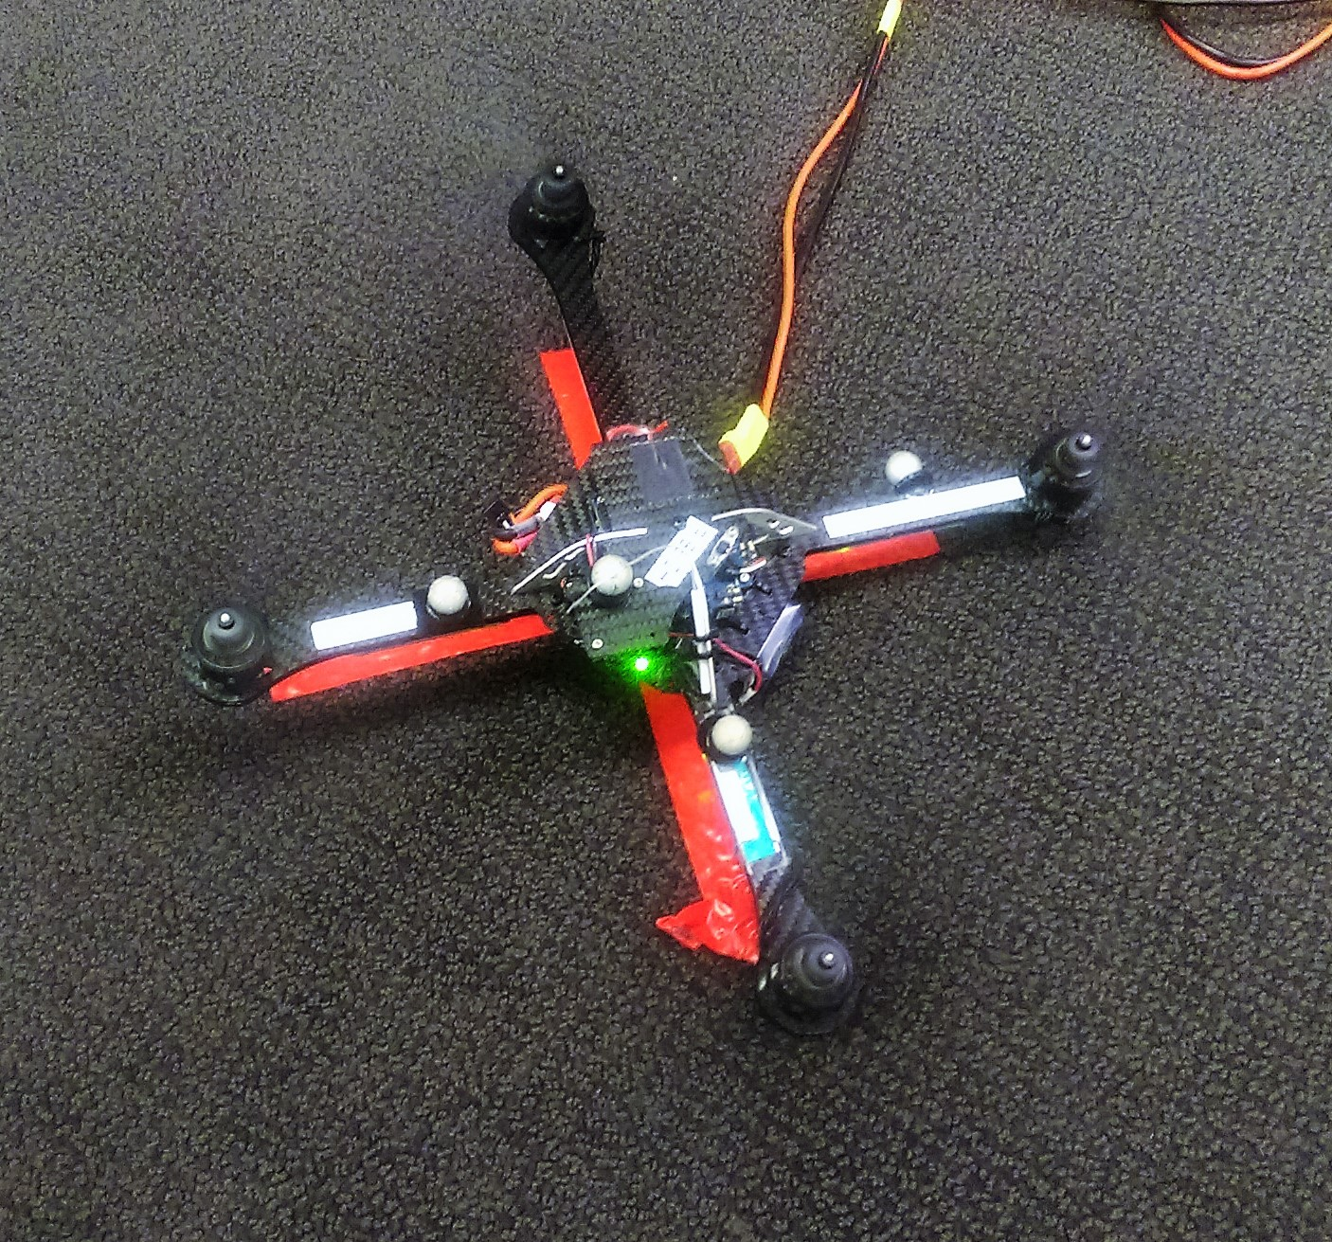
Flight System Failure Test
Manual Flight
Establish communication with DC power supply sensors
Establish communication with Indoor positioning system
Connect Vehicle and DC power supply
Setup
Turn on Vehicle
Establish communication with vehicle
Launch Automatic Testing Software
Observe vehicle as it performs test maneuvers
Testing Software Automatically Shuts Down
Yes
No
Perform Another Test
Cease Testing
Notes:
Formal test procedure
Manual flight – uav working prior to repeated tests
Test setup, start auto test sw, watch test maneuvers, auto test sw shutsdown, change log, start another test
Cage, motion capture cameras and reflective markers, + reduce test bias

Slide 9
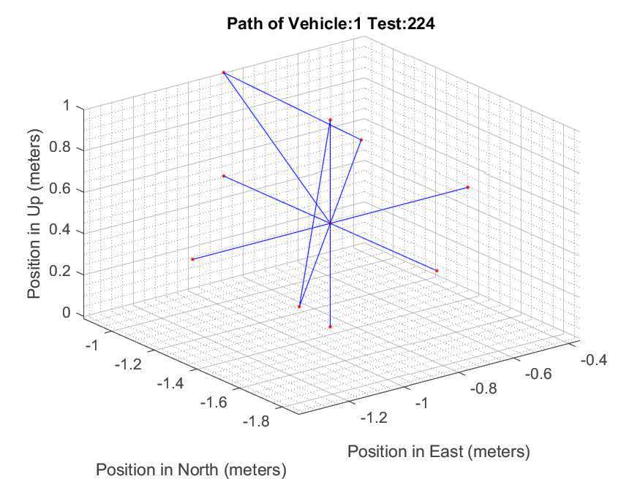
Automated Test Maneuvers
Startup motors
Pitch and roll tests
Launch
Two Axis Translations
w and w/o Rotations
Rotations
Single Axis Translations
w and w/o Rotations
Three Axis Translation
w Rotation
X
X
Down Translation
Land
Shutdown Motors
Notes:
Test operation of motors; 90,180, cw, ccw; 1; 2; 3; land and turn off motors for next test
Replicate basic rotor craft flight maneuvers

Slide 10
Presentation Outline
Flight System Test Setup
Reliability and Failure
Under what conditions does an unmanned aerial vehicle fail?
How reliable is each unmanned aerial vehicle?
Time and Time Delay
Radio Range
Future Work and Conclusions
Notes:
Now discuss Project Investigation Topic
Under what conditions does an unmanned aerial vehicle fail?
How reliable is each unmanned aerial vehicle?

Slide 11
Flight System Failures
Notes:
types of failures through repeated flight.
Under these conditions a UAV fails
Hw vs all failures, relate rw; comm interrupt; control input;
Packet time delay signifiicant
Research Question, Setup, Results, and Implication
discuss takeaways from slide; why tests show something valuable; what others can learn from them.

Slide 12
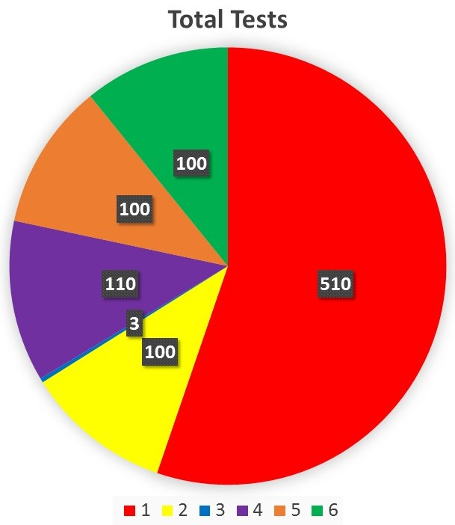
Flight System Tests Per Vehicle
Vehicle | Vehicle Type | Propeller | Day 1 | Day 2 | Day 3 | Day 4 | Day 5 | Day 6 | Day 7 | Day 8 | Day 9
1 | AscTec Hummingbird | AscTec Safety | 10 | 100 | 100 | 200 | 100 | 0 | 0 | 0 | 0
2 | AscTec Hummingbird | AscTec Safety | 0 | 0 | 0 | 0 | 0 | 0 | 0 | 100 | 0
3 | AscTec Hummingbird | AscTec Safety | 0 | 0 | 0 | 0 | 0 | 0 | 0 | 3 | 0
4 | AscTec Hummingbird | AscTec Normal | 10 | 0 | 0 | 0 | 0 | 100 | 0 | 0 | 0
5 | AscTec Hummingbird | ARDrone | 10 | 0 | 0 | 0 | 0 | 10 | 80 | 0 | 0
6 | ARDrone | ARDrone | 0 | 0 | 0 | 0 | 0 | 0 | 0 | 0 | 100
Notes:
923 total flights using 6 vehicles were performed.
Average 100
Describe vehicle 3 test amount

Slide 13
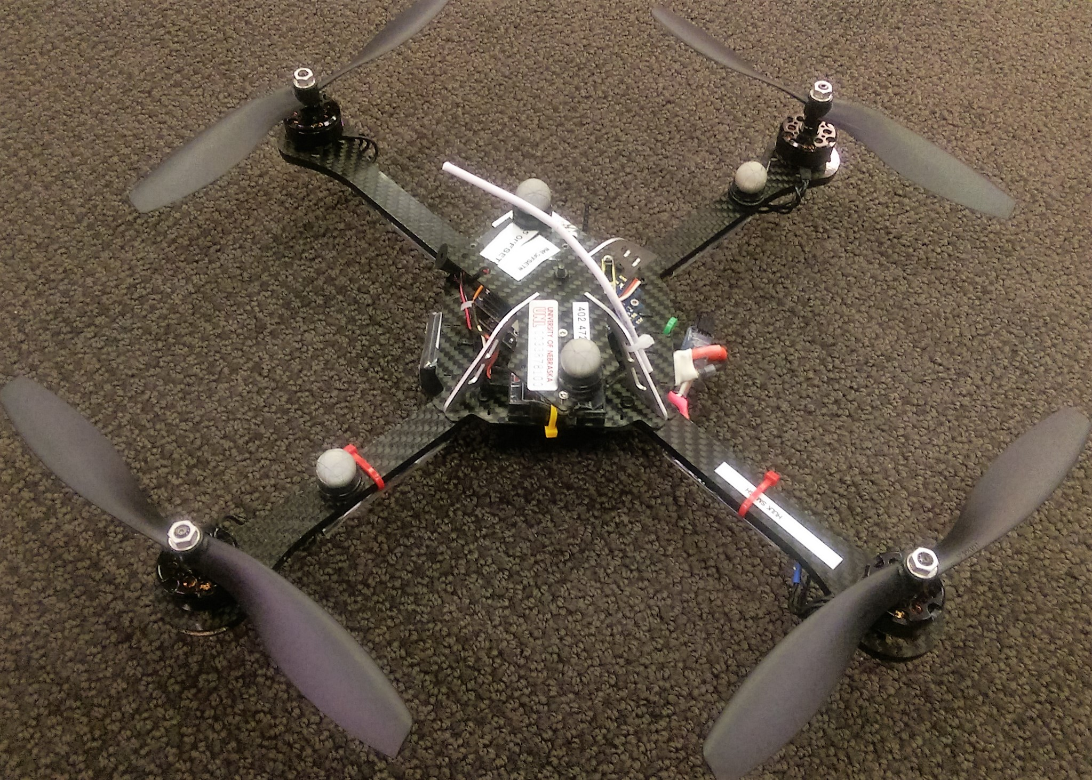
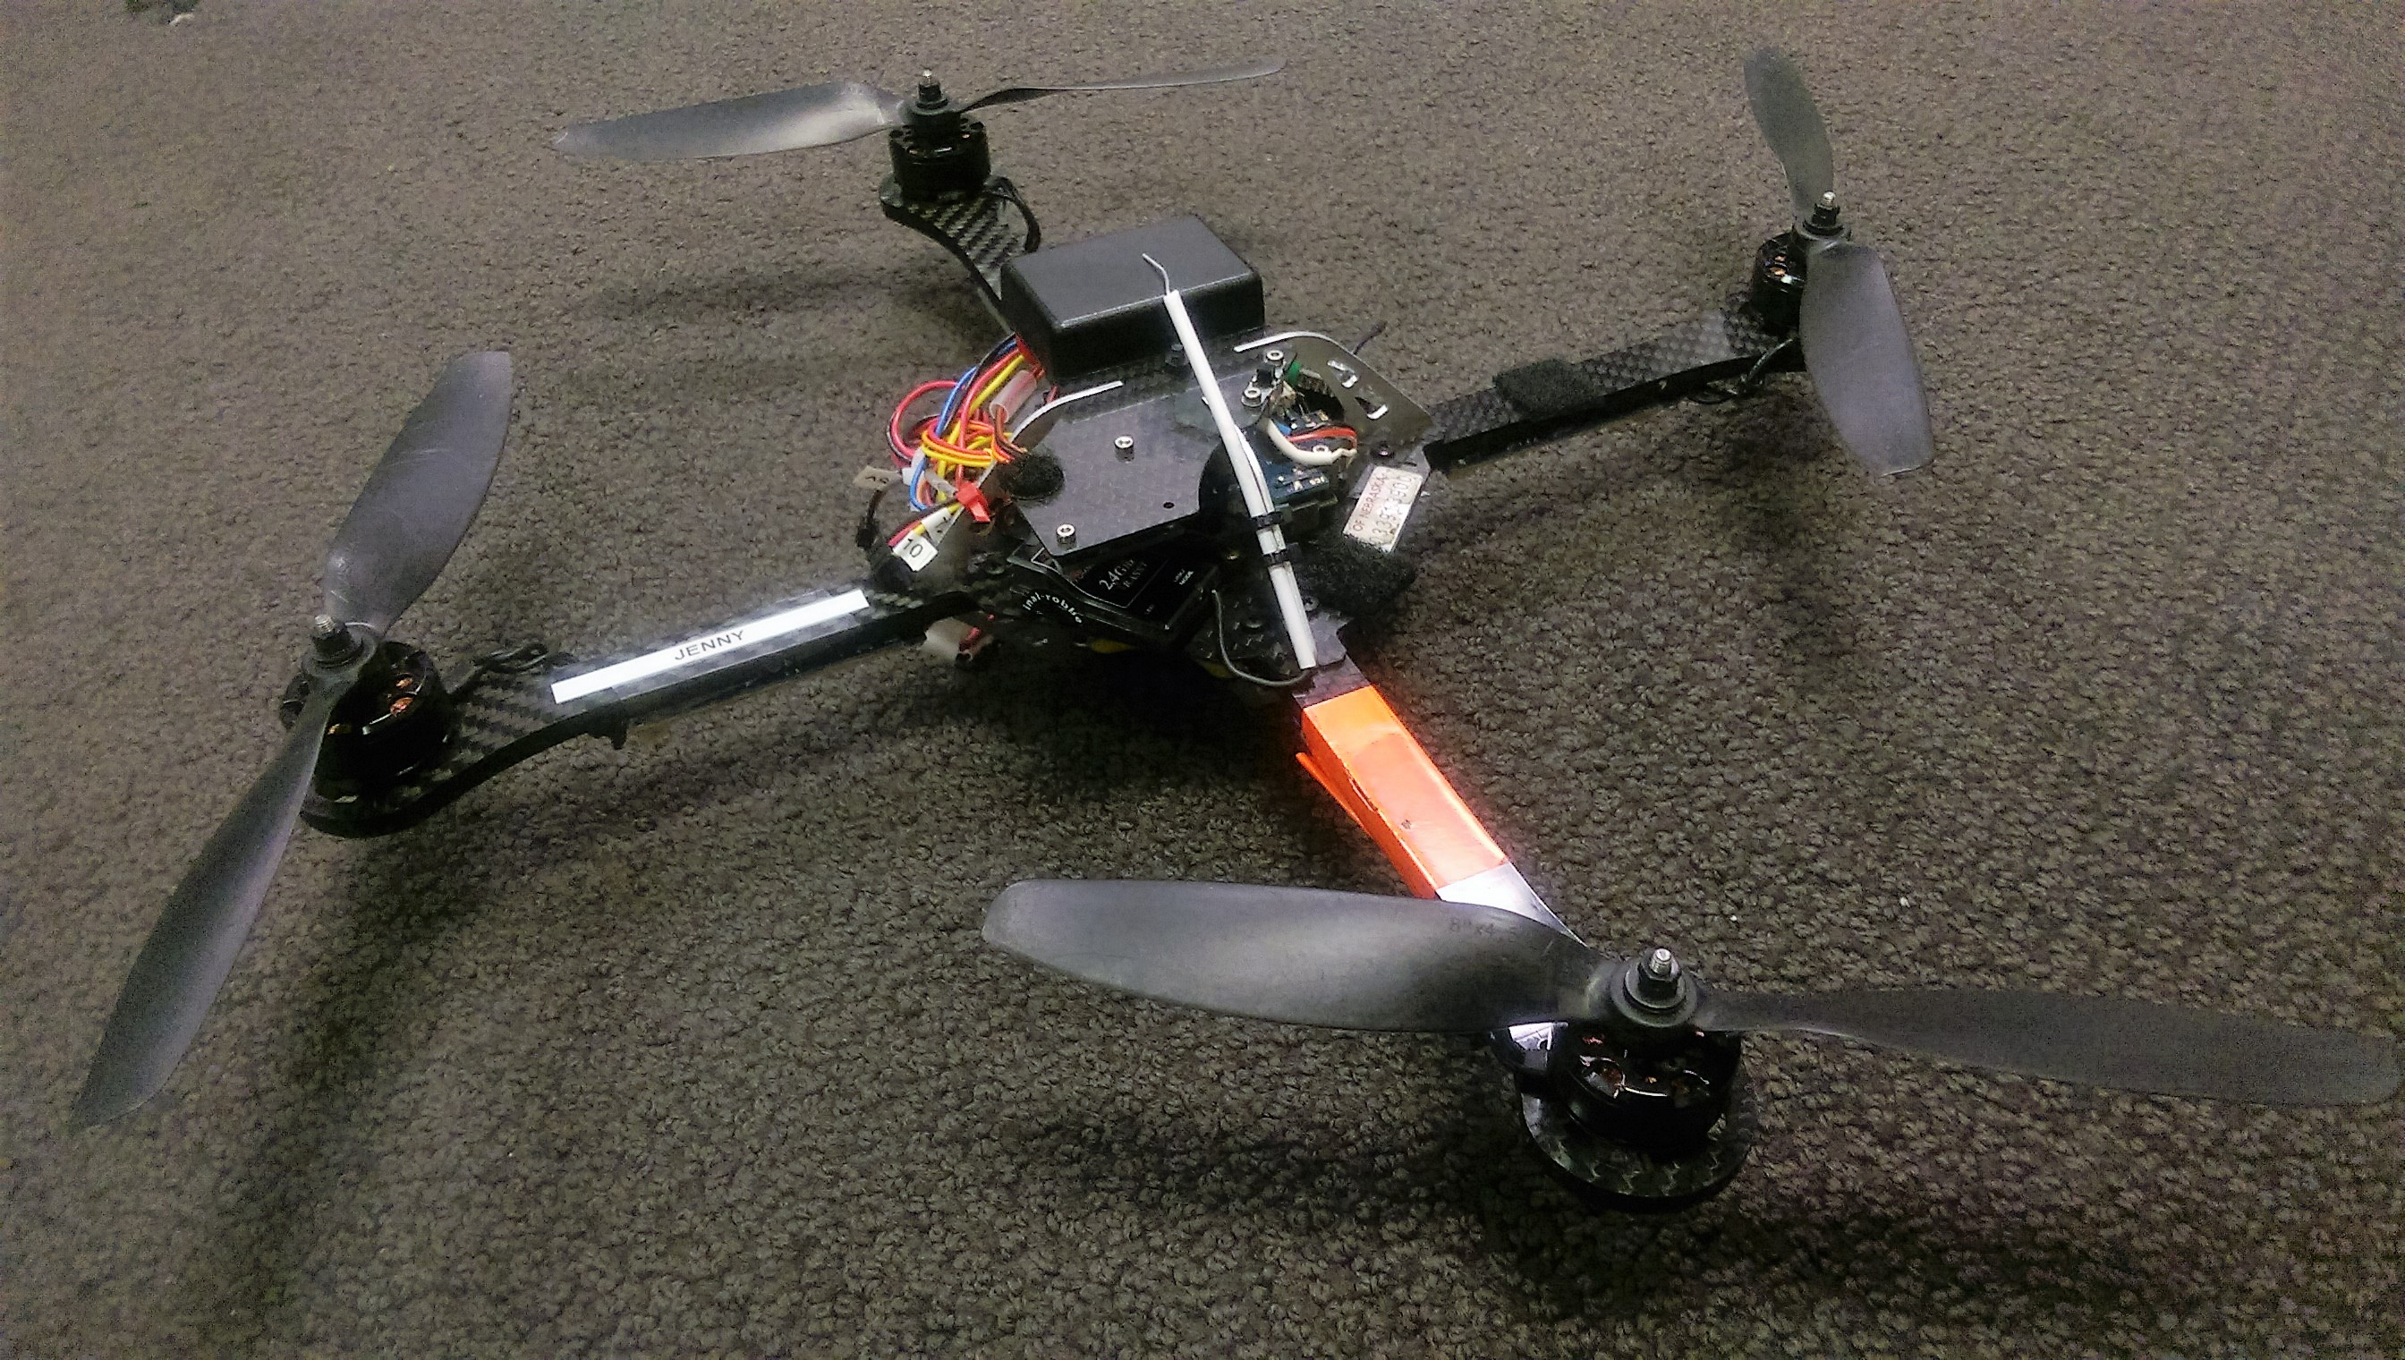
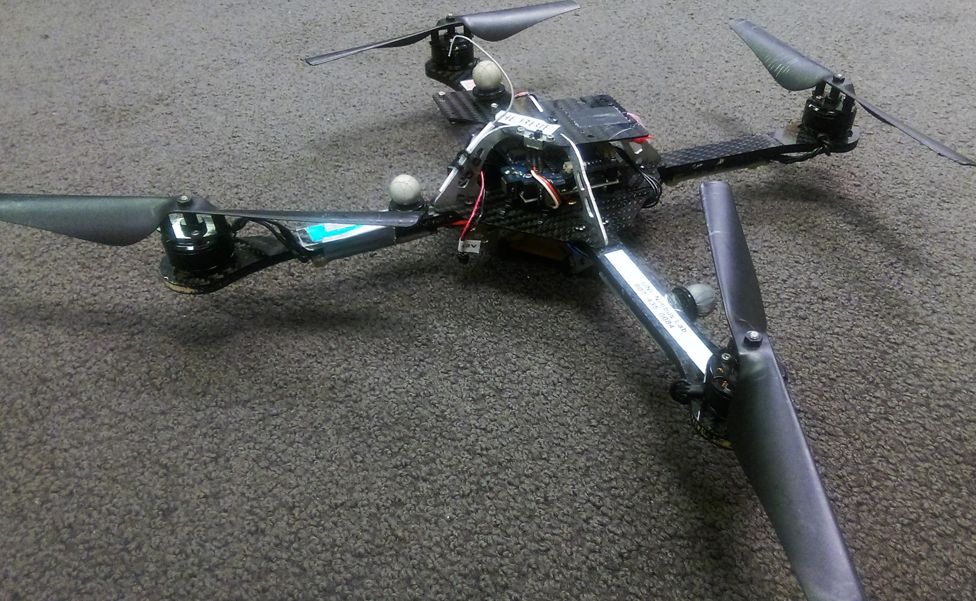
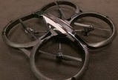
Flight System Failure Analysis Vehicle Type
Vehicle | Vehicle Type | Propeller | Failed Tests | Total Tests | Failure Rate (%)
1 | AscTec Hummingbird | AscTec Safety | 78 | 510 | 15.294
2 | AscTec Hummingbird | AscTec Safety | 4 | 100 | 4.000
3 | AscTec Hummingbird | AscTec Safety | 1 | 3 | 33.333
4 | AscTec Hummingbird | AscTec Normal | 33 | 110 | 30.000
5 | AscTec Hummingbird | ARDrone | 14 | 100 | 14.000
6 | ARDrone | ARDrone | 10 | 100 | 10.000
1-3
4
5
6
Notes:
Vehicles 1-5 Hummingbird, 1-3 Safety, 4 Normal, 5 ARDrone, 6 is ARDrone, w/ ARDrone,
These are the failure rates per vehicle.
Individual vehicle failure rates ranged from 4-33%.
Why multiple of one type?
Vehicle 3 fail rate

Slide 14
Reliability of Each Unmanned Aerial Vehicle
Failure Rate (%)
Notes:
failure rates per vehicle broken into fail type
discuss why this is important and what can be learned from this.
Now present failure example

Slide 15
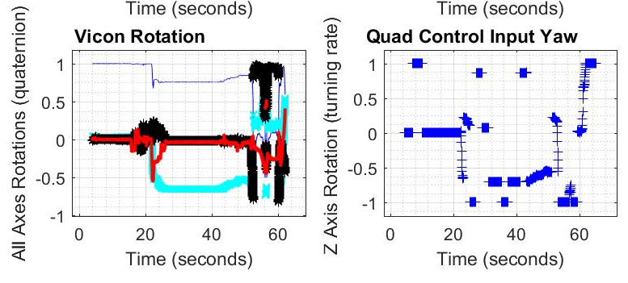
Failure – Motor Assembly
Legend: Pitch Roll Yaw 4th Quartenion
Notes:
Hardware failures accounted for 5 failures. Motor assembly failure
Rocking and time 20; movement in xy plane; Qci try to compensate
discuss why this is important and what can be learned from this.

Slide 16
Presentation Outline
Flight System Test Setup
Reliability and Failure
Time and Time Delay
Is the execution time for a failed test the same as the average time for a successful test?
Radio Range
Future Work and Conclusions
Notes:
Is the execution time for a failed test the same as the average time for a successful test?

Slide 17
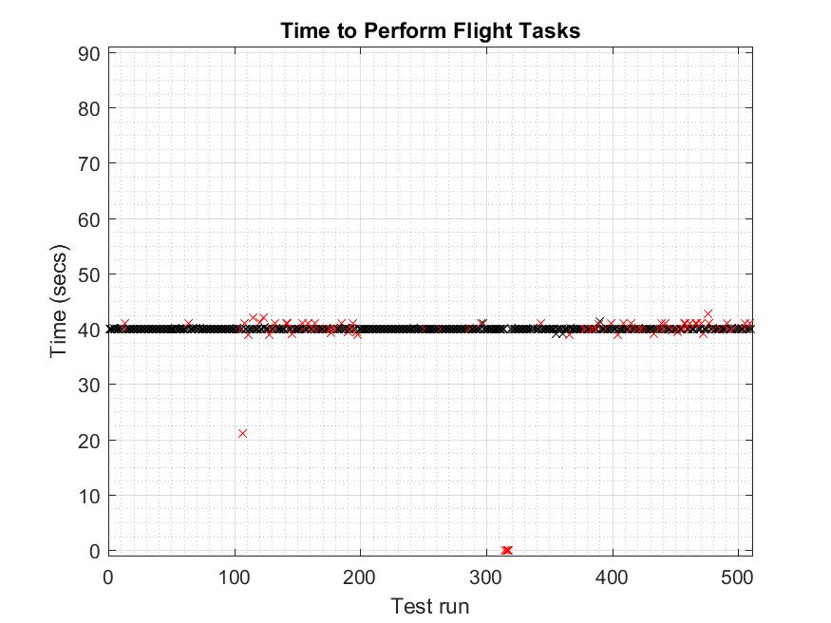
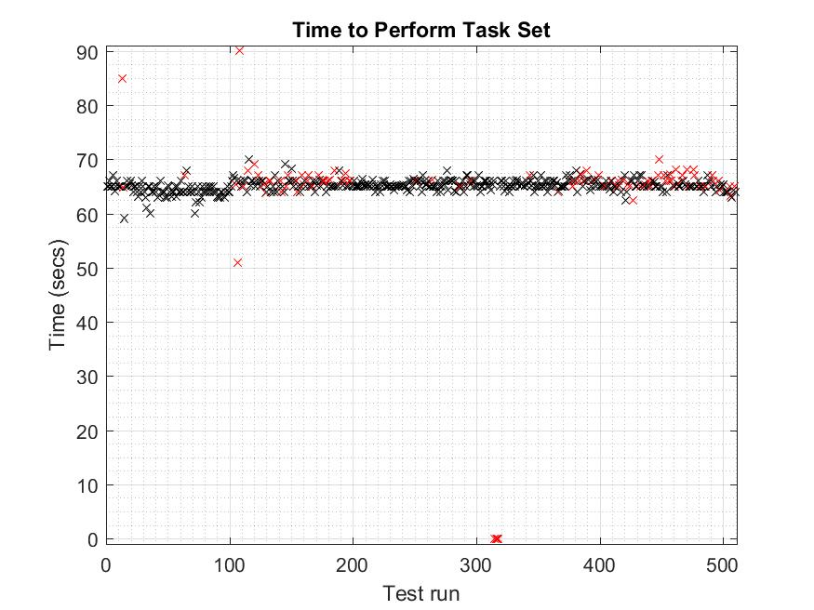
Test Execution Time
Legend: Failed Tests Successful Tests
Notes:
Time between launch command when completion of land command
Overall execution time an indicator Fail tested? Better indicator – individual topic time
Is the execution time for a failed test the same as the average time for a successful test?

Slide 18
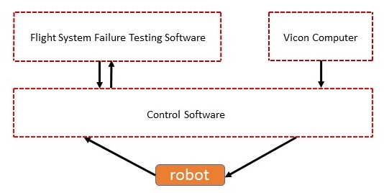
Simple Control Diagram
Process/Thread
Cat5E
XBee-Pro
XBee-Pro
Notes:
from sensor request to control input
Longest path: 12 messages need to be published, sensor (robot), time delay
6th msg longest path – Testing Software
Shortest path: 6 messages, sensor (Vicon) → control input
The following example display delay Vicon and control, there are delays on long path

Slide 19
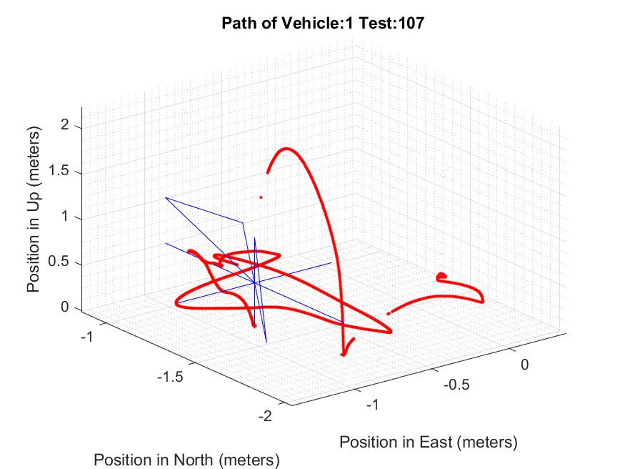
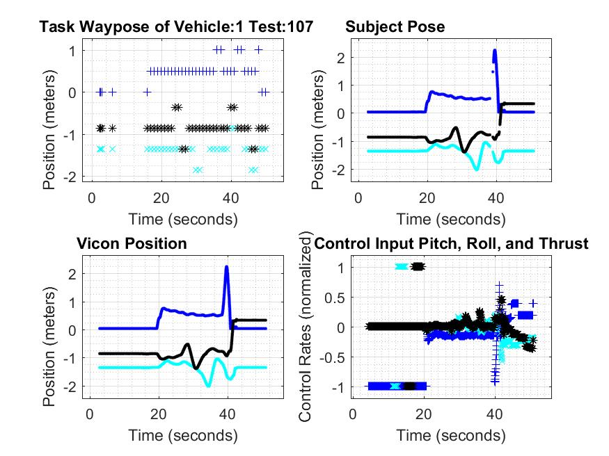
Packet Time Delay
Legend: East North Up
Legend: Control Software Position Target Position
Notes:
This time delay will cause the controlled system to exhibit unexpected behavior.
discuss why this is important and what can be learned from this.

Slide 20
Presentation Outline
Flight System Test Setup
Reliability and Failure
Time and Time Delay
Radio Range
What is the effective radio range of paired XBee-Pros?
Which antenna length combination results in furthest range?
Future Work and Conclusions
Notes:
What is the effective radio range of paired XBee-Pros?
Which antenna length combination results in furthest range?

Slide 21
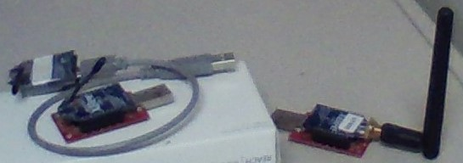
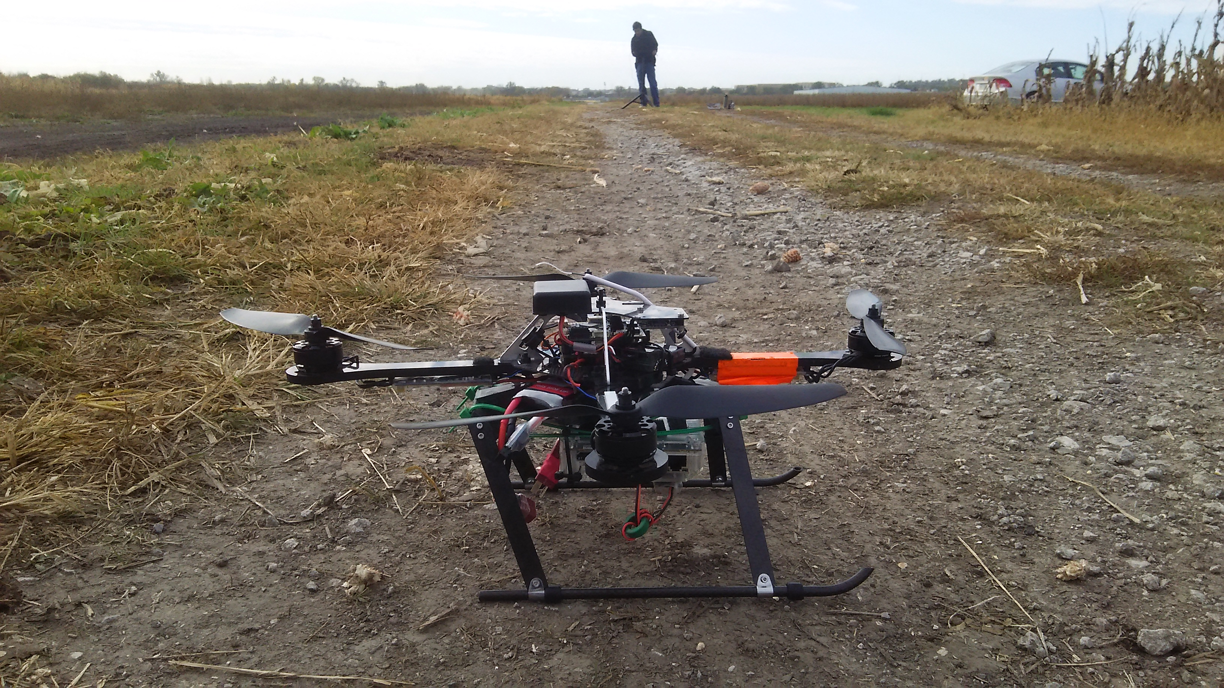
Radio Range Test Setup
Notes:
Most short duration UAVs require radio communication with a ground station.
International XBee-Pros have a specification outdoor range of up to 750 m.
ZigBee radios common due to their
low cost,
low power consumption,
and compact form factor.
Test at Havelock

Slide 22
Radio Range Test
Setup
Setup Wireless Router
Launch Radio Range Testing Software on Controlling Station
Power UAV and Odroid Xu4
Launch Radio Range Testing Software on Odroid
Perform Pre-flight Checks of Battery, GPS, and RSSI Status
Manually Pilot Vehicle to 50 Meters Altitude and 15.24 Meters Forward
No
Yes
Change Battery
Land Vehicle
No
Perform Another Test
Yes
Cease Testing
Notes:
Steps performed for every test location
What data is collected
Target altitude 50 m; 15.24 m separate; RSSI

Slide 23
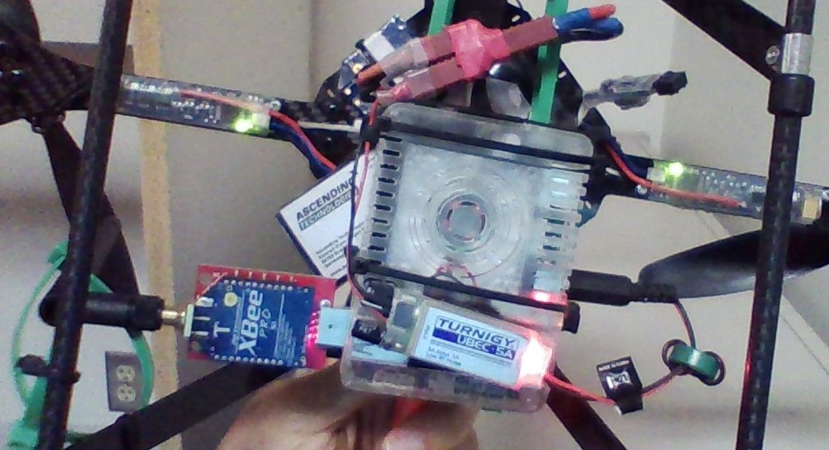
Odroid Configurations
Odroid Configuration | Position | Fan Facing | Power Regulator
1 | Fixed | Towards UAV | Near Power Splitter
2 | Rails | Away From UAV | Away From UAV
Odroid Configuration 2
Notes:
Two Odroid configurations were used
Effected RSSI
discuss why this is important and what can be learned from this.
The placement of a radio on an unmanned aerial vehicle with respect to the surrounding electronics effects received signal strength of the receiver.

Slide 24
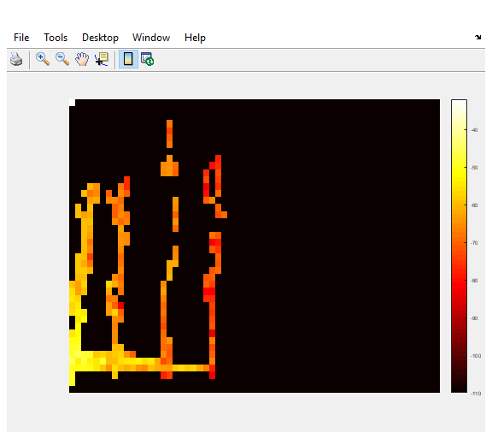
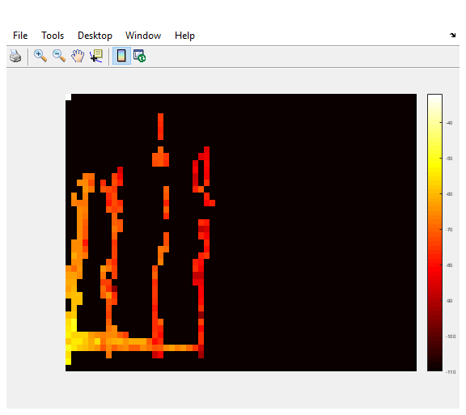
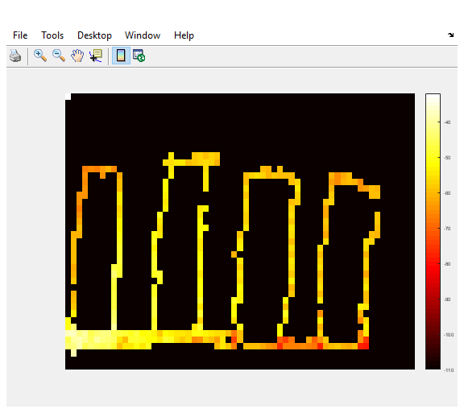
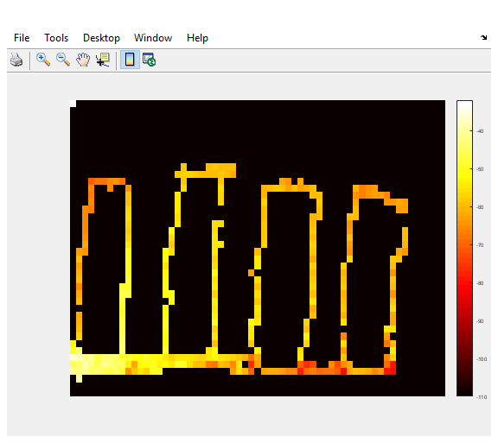
RSSI
Controlling Station XBee-Pro
Odroid XBee-Pro
Odroid Configuration 1
Odroid Configuration 2
Altitude
Horizontal Distance
Notes:
RSSI (dBm) – Range [-110, -32], define RSSI
Both XBee-Pros with 2.4 GHz 1/4 wavelength antennas (1.0”)
Vertical vs Horizontal distance (meters) – 76 m-by-120 m
Lines = flight path where a packet was received
There is a difference between indicated RSSI values of Xbee-Pro pair
discuss why this is important and what can be learned from this

Slide 25
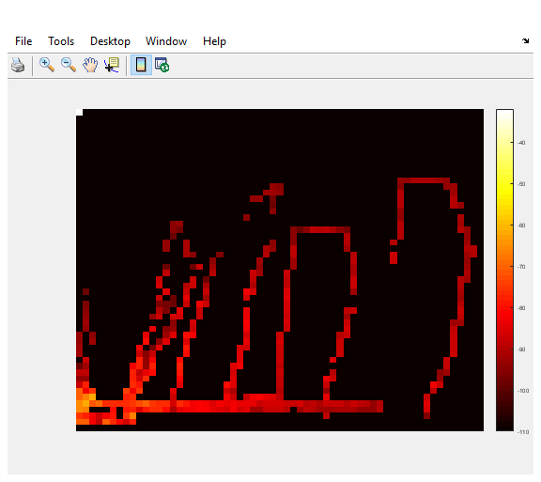
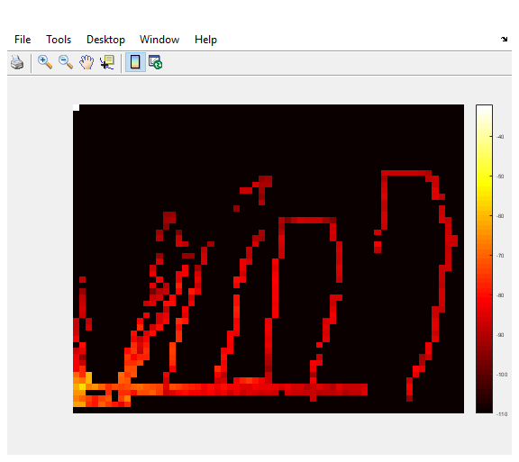
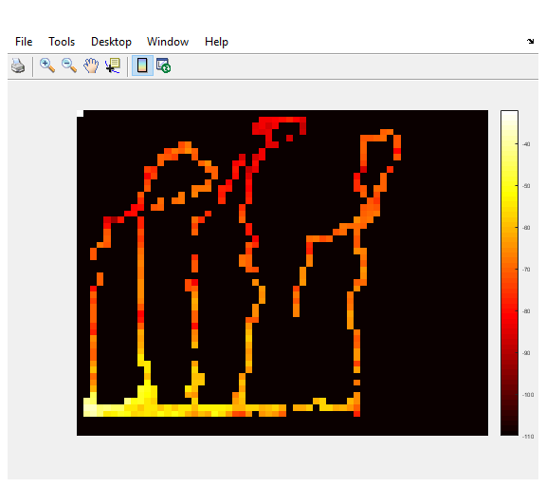
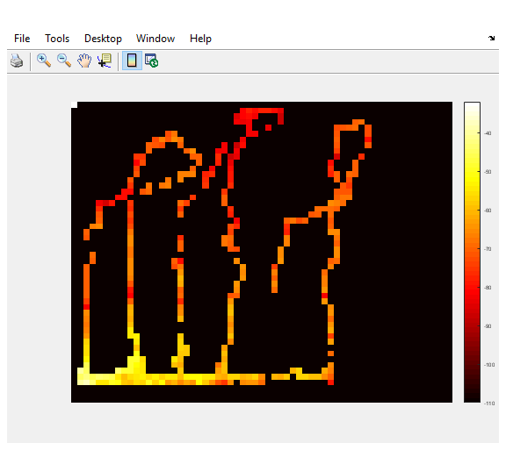
RSSI
Controlling Station XBee-Pro
Odroid XBee-Pro
Odroid Configuration 1
XBee-Pro USB Assembly 1
Odroid Configuration 2
XBee-Pro USB Assembly 2
Altitude
Horizontal Distance
Notes:
Both XBee-Pros with 900 MHz 1/4 wavelength antennas (3.5”)
Vertical vs Horizontal distance (meters) – 96 m-by-120 m
discuss why this is important and what can be learned from this.

Slide 26
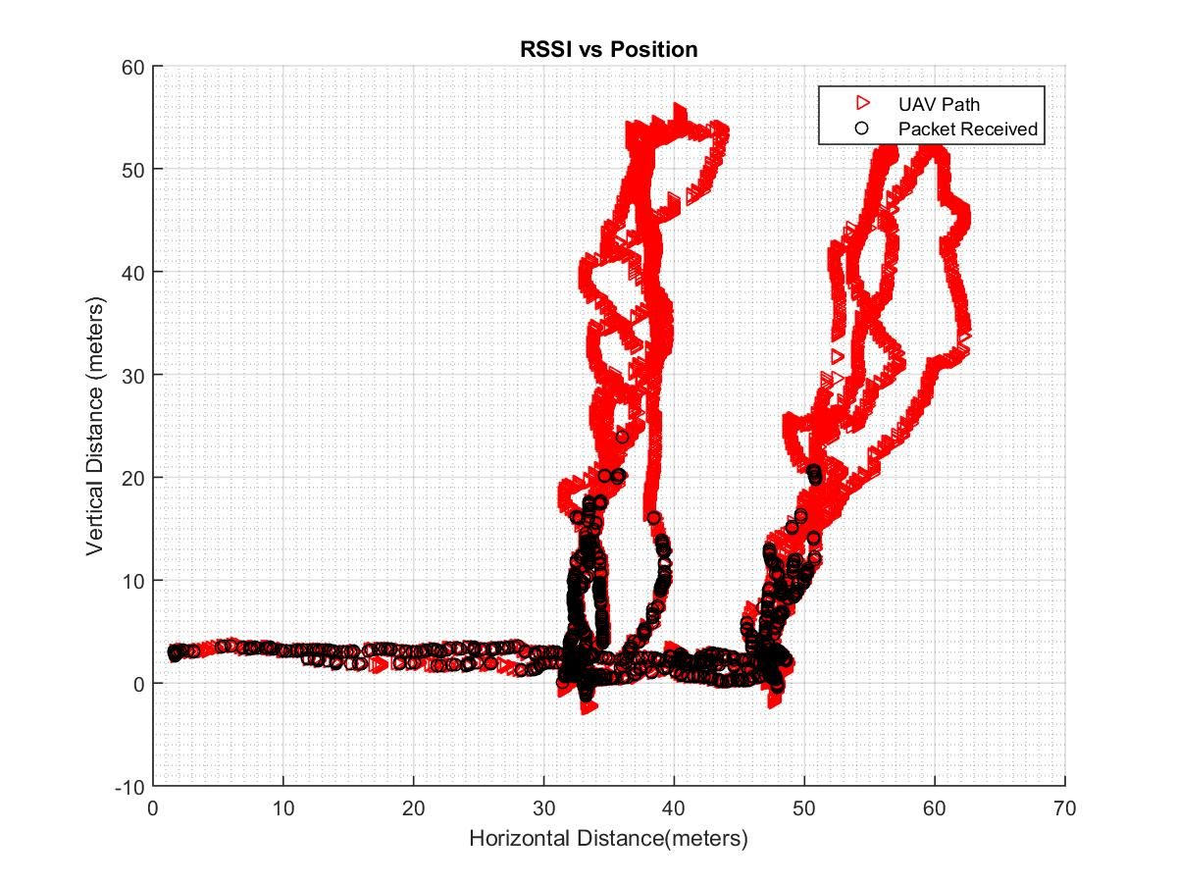
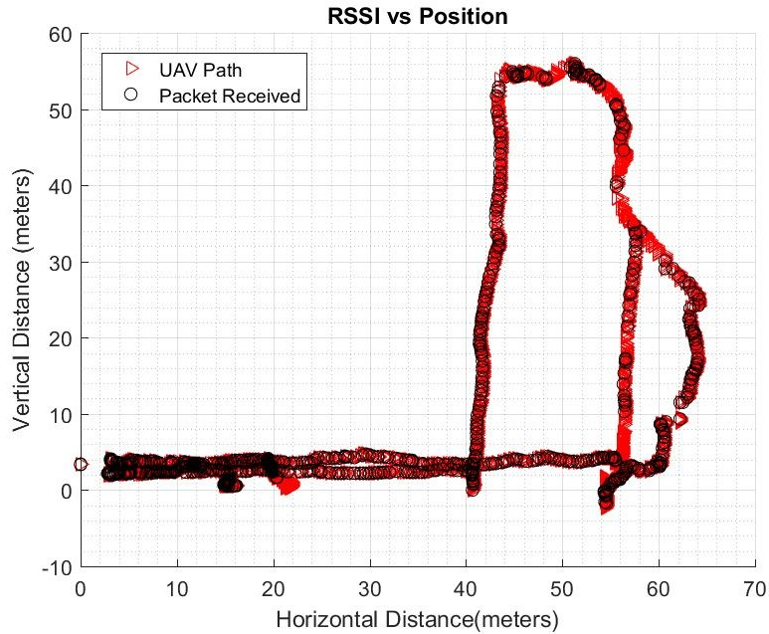
Defective XBee-Pros
Notes:
explain UAV path
time stamp sync GPS and RSSI
2 defective XBee-Pros, 1 defective Xbee-Pro
discuss why this is important and what can be learned from this.

Slide 27
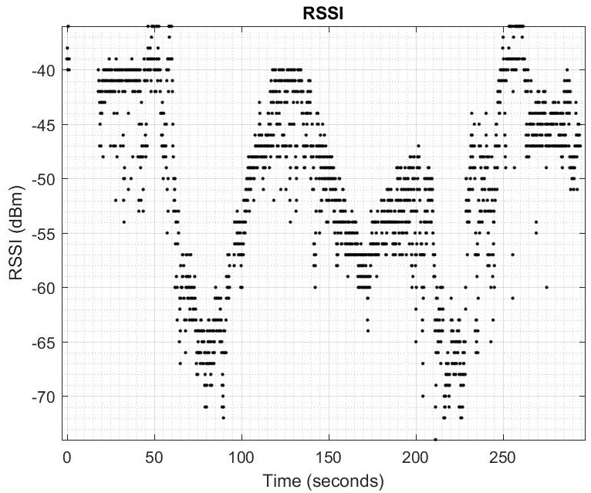
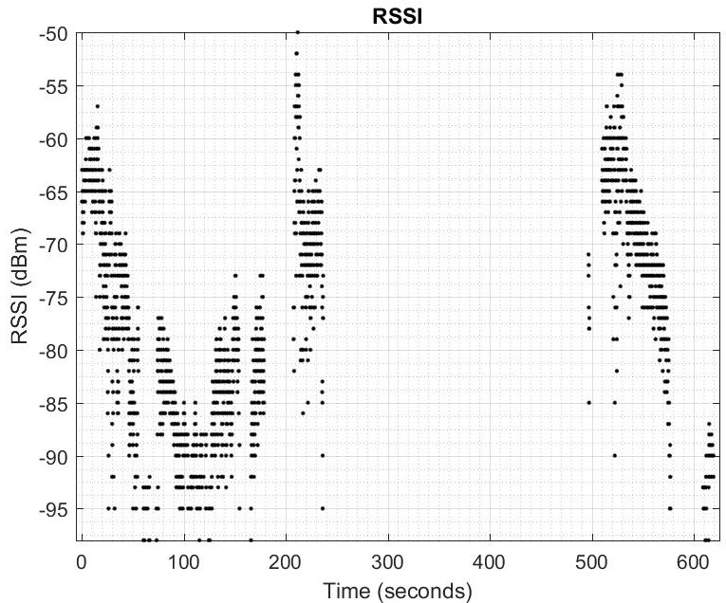
RSSI w.r.t Time
Notes:
Illustrate quantized proper RSSI vs improper RSSI values
Odroid power cycle
discuss why this is important and what can be learned from this.

Slide 28
Presentation Outline
Flight System Test Setup
Reliability and Failure
Time and Time Delay
Radio Range
Future Work and Conclusions
Notes:
The following

Slide 29
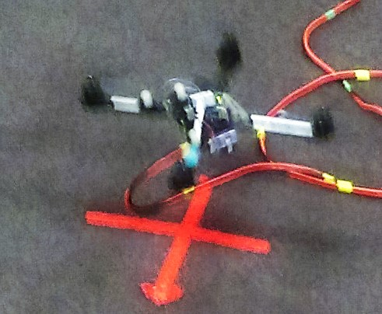
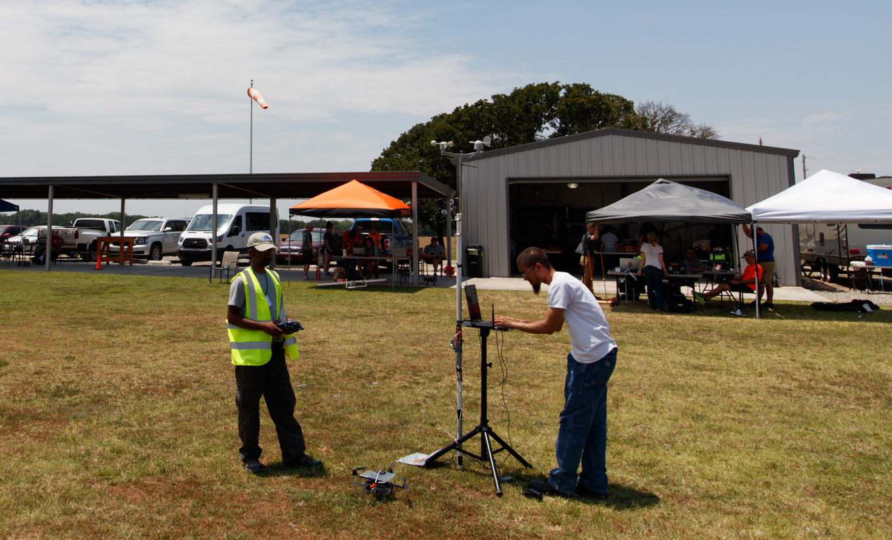
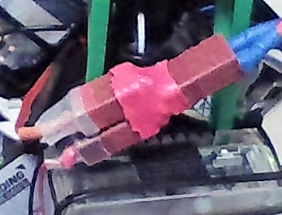
Future Work
Motor assemblies trust model
Integrate control software with other UAVs
Reliable power splitting solution
Automate outdoor navigation task
Full XBee-Pro range testing.
Notes:
to remind people of what you did.
Navigation task for radio test, manual piloted, test and automate outdoor nav

Slide 30
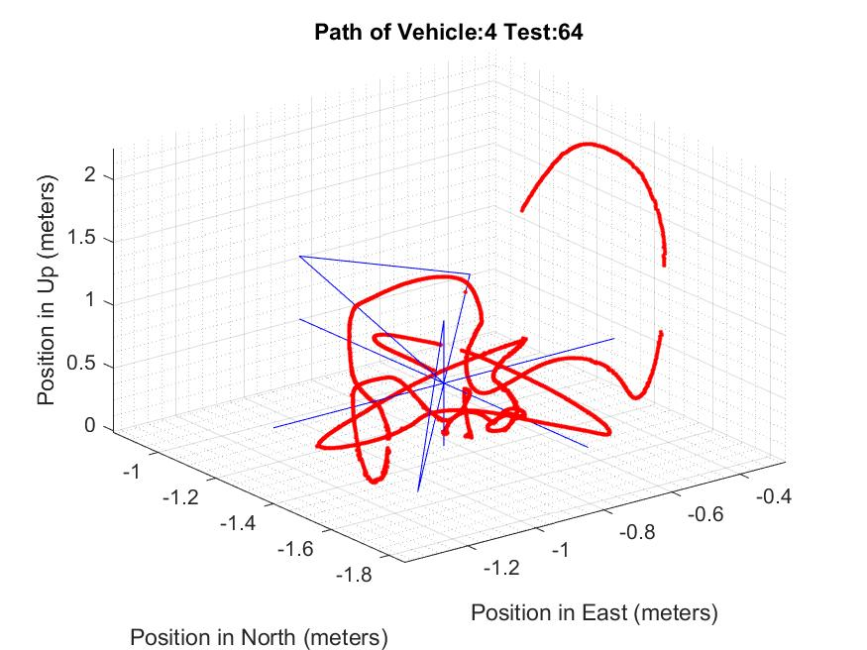
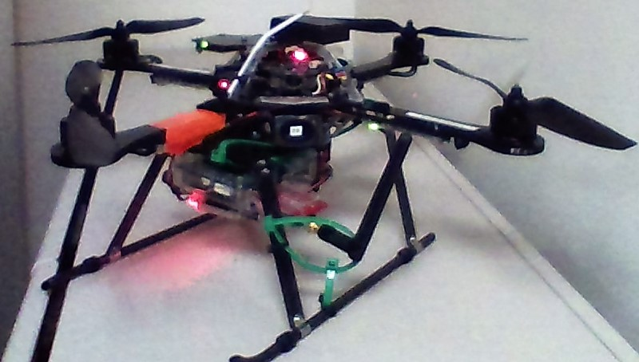
Flight System Failure Conclusions
Reduce undesired packet delays
No correlation power fluctuations
ARDrone propellers and power
Propeller type versus position error
Notes:
Rotor craft, hover, presence of delayed packets, safer system
No correlate Power and vehicle performance
ARDrone propellers → increased power consumption, no difference other 2 types.
Propeller type, no effect, position error measurements

Slide 31
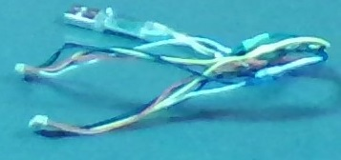
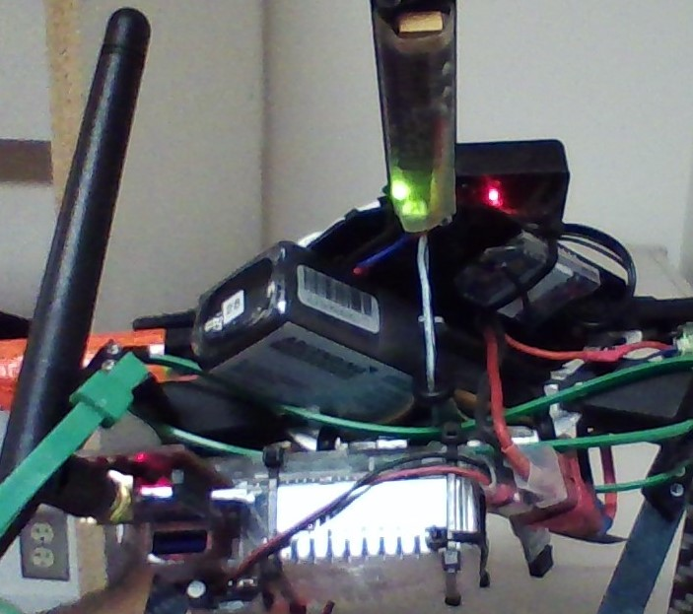
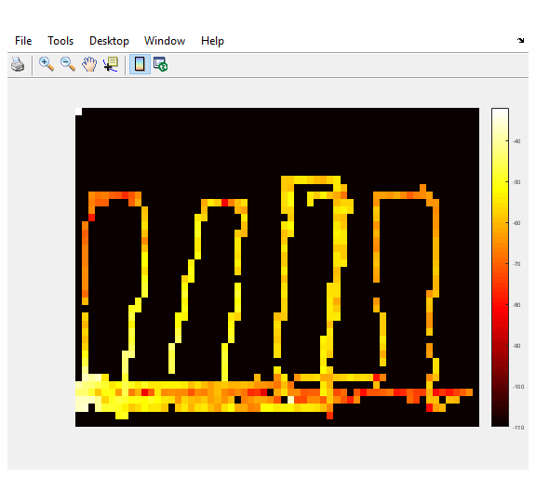
Radio Range Conclusions
Multiple USB devices
Effective radio range
Alleviate test bias
Reliable power splitting solution
Notes:
>=2 USB devices on different channels, same baud rate, different topics: require different ROS namespaces = reliable communications.
effective radio range tested so far < International XBee-Pros (750 m)
Reliable power splitting solution, safer quicker testing
A full set of tests conducted with equipment (2 XBee-Pros with attached 2.4 GHz 1/4 wavelength antennas, 2 XBee-Pros with attached co-axial connection, 4 Sparkfun Explorer Dongles, 2 co-axial normal-mode helical 900 MHz 1/4 wavelength antennas) purchased at the same time would alleviate test bias.

Slide 32
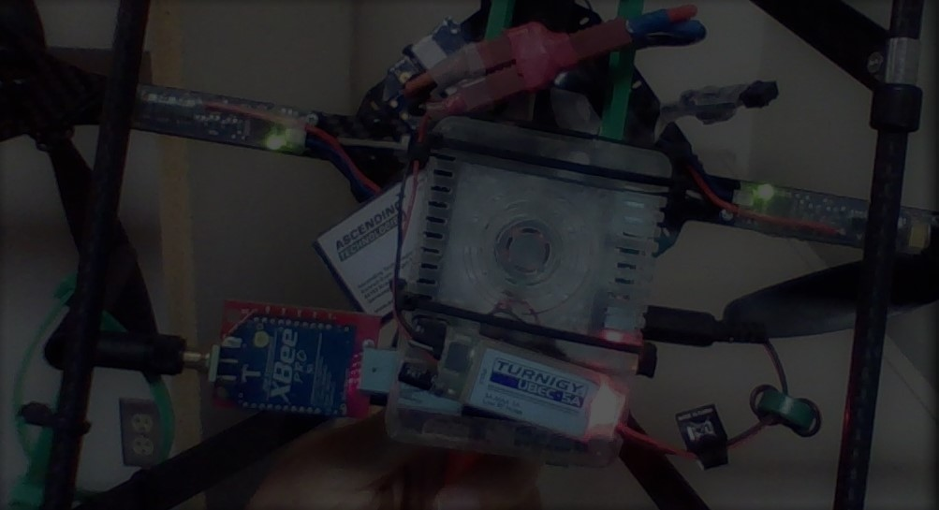
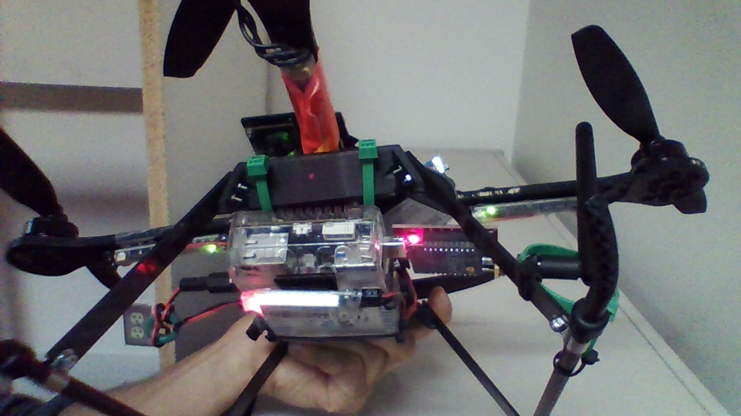
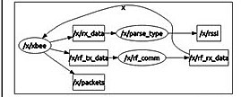
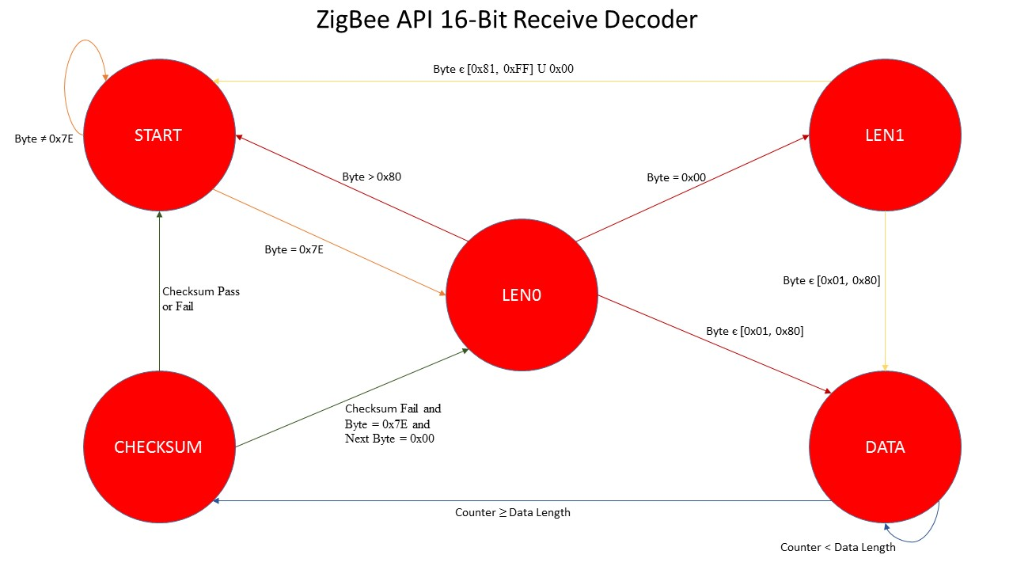
Contributions and Lessons Learned
Time delayed packets and safe flight
Positioning System network
Serial communication interruption
Positioning System
Hardware degradation over time
Notes:
89% of 140 failed flights out of 923 flights, time delayed packets. safe flight, packet time delay: pre-flight check update rates: sense, control; monitor message time delay, make a decision
improperly configured network device caused 4 test failures; properly configure, devices pose sys network; pre-flight check of devices connected, warning system new devices
Serial communication was interrupted during 6 flight; using USB radio device, actively monitor for pipe halts and/or stalls.
indoor positioning, blocked, markers can be obfuscated, GPS denied scenario; pre-flight check positioning system operating; monitor for abnormal values, perform a safety action.
Hardware exhibit performance degradation over time. placement of a radio on a rotorcraft, surrounding electronics, RSSI; Careful placement of a radio, pre-flight check of rssi, adjust radio and/or electronic devices; monitor RSSI for abrupt changes

